Slide 1
Organization VitaTrack Wellness

Slide 2
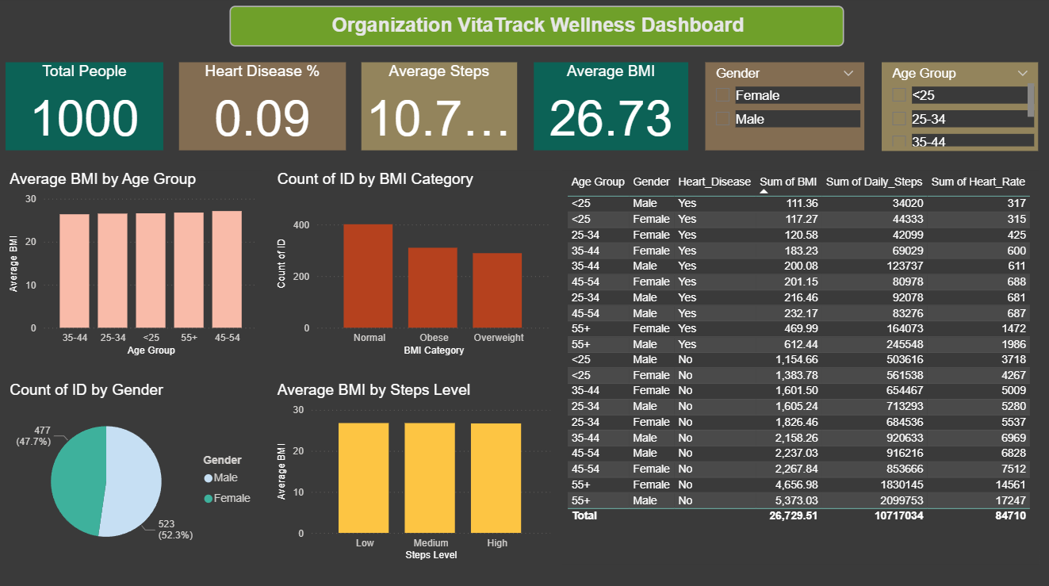

Slide 3
1. Balanced Lifestyle (Daily Steps, Calories Intake, and Sleep)
The dataset indicates that users maintain an average of 10,700 steps per day, which falls in the moderate to active range. If supported by adequate sleep duration (7–8 hours) and balanced calorie intake, users demonstrate a generally healthy and balanced lifestyle.
Finding: Most individuals maintain moderate activity levels, suggesting balanced physical routines with minor scope for improvement in sleep consistency and dietary habits.
2. Heart Disease Risk Based on Lifestyle Habits
Approximately 9% of individuals have reported heart disease. Analysis shows that people with higher BMI, low daily steps, and smoking or alcohol consumption fall under higher-risk categories. Heart disease prevalence is slightly higher among males aged 45 and above.
Finding: High BMI, low activity levels, smoking, and alcohol intake significantly increase the likelihood of heart disease.
3. Relationship Between Sleep and Physical Activity
The dashboard suggests a positive relationship between physical activity and sleep. Users with higher daily step counts tend to maintain healthier BMI levels and better sleep quality, while less active individuals often experience irregular sleep patterns.
Finding: Improved physical activity promotes better sleep and overall metabolic health.
4. BMI Variation Across Age Groups and Genders
The average BMI is 26.73, which is slightly above the normal range. BMI remains fairly stable across age groups but shows a slight increase in the 45–54 and 55+ categories. Males exhibit a marginally higher BMI compared to females.
Finding: BMI tends to rise with age, emphasizing the importance of maintaining regular exercise and healthy dietary habits.
5. Impact of Smoking and Alcohol on Heart Rate and Blood Pressure
Smokers and frequent alcohol consumers show elevated heart rates and higher blood pressure compared to non-smokers and low-alcohol consumers. This confirms that such lifestyle choices adversely affect cardiovascular health.
Finding: Unhealthy habits like smoking and alcohol consumption increase cardiovascular strain and hypertension risk.

